Slide 1
SC1015
MINI PROJECT
FDDC Group 1
Tan Ming Hao
Cho Zhi Wei
Lai Xin Yee

Slide 2
TABLE OF CONTENTS
01
02
Motivation
Set The stage
03
04
Core ANALYSIS
oUTCOME
Why are we analysing on diabetes?
Data cleaning and Exploratory Data Analysis
Machine Learning Models
What we conclude from the data & what we learn
T
0

Slide 3
Our motivation
01
This can be the part of the presentation where you introduce yourself, write your email…
T
0

Slide 4
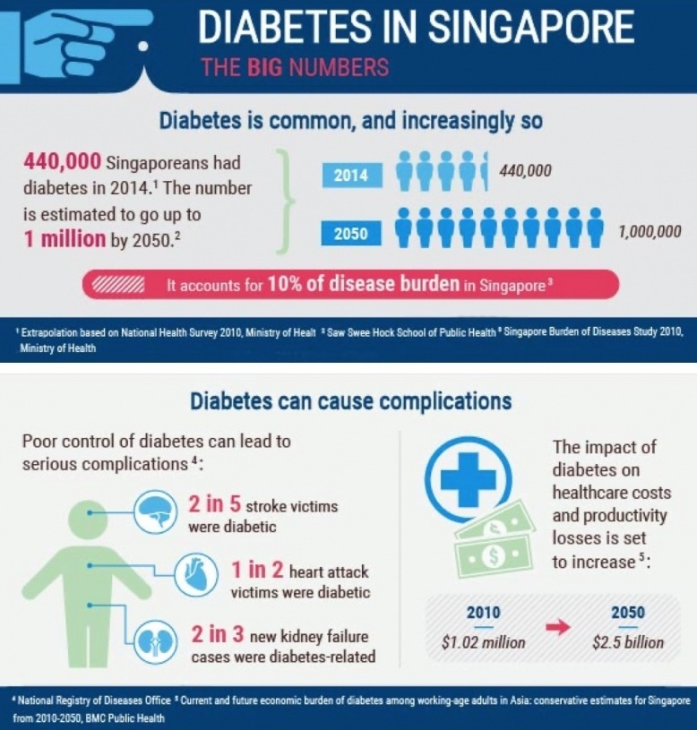
MOTIVATION
T
1

Slide 5
MOTIVATION
To predict the probability of one getting diabetes using Data Science
To provide insights for people to adopt a healthier lifestyle
To raise the awareness of diabetes prevention and early detection

Slide 6
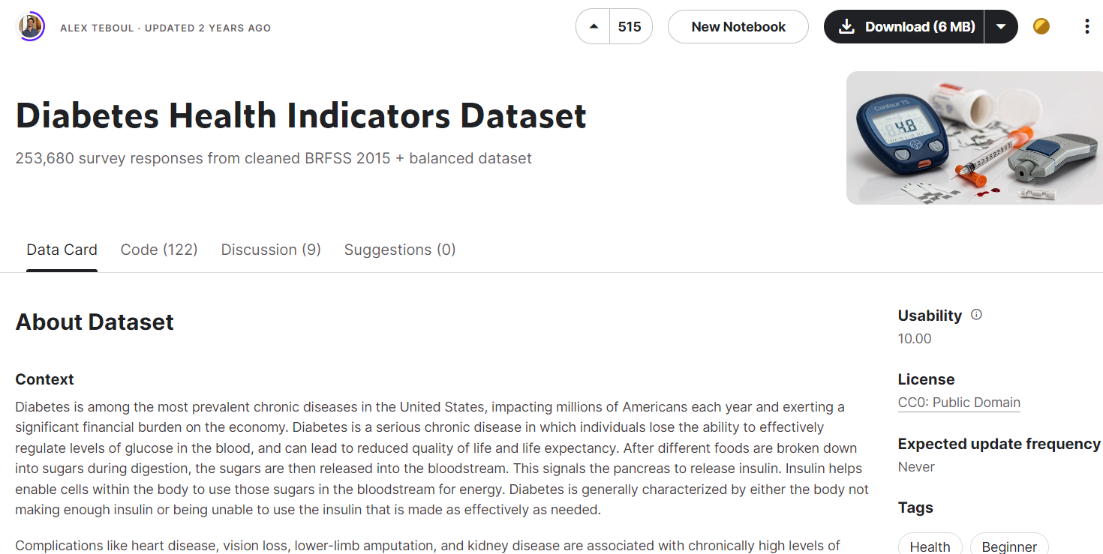
DATASET
Diabetes Health Indicators Dataset in Kaggle
Created by ALEX TEBOUL
Around 250k survey responses

Slide 7

PROBLEM STATEMENT
WHAT ARE THE MAIN FACTORS THAT CONTRIBUTE TO DIABETES?

Slide 8
02
Set
The stage
Exploratory Data Analysis
T
1

Slide 9
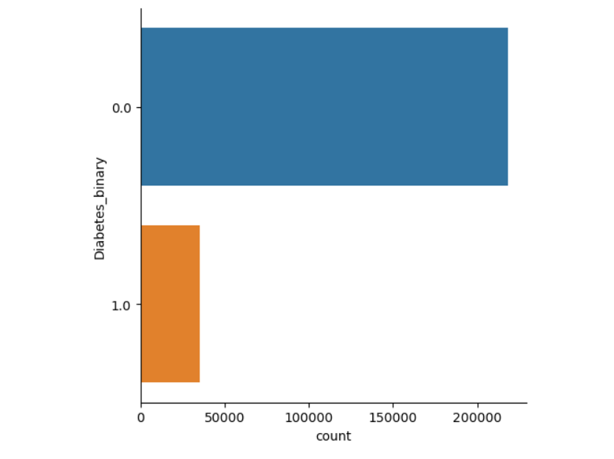
DATA CLEANING

Slide 10
DATA CLEANING
Problem of Imbalanced Dataset:
Poor model performance
Misleading performance metrics
Way to overcome Imbalanced Dataset:
Undersampling

Slide 11
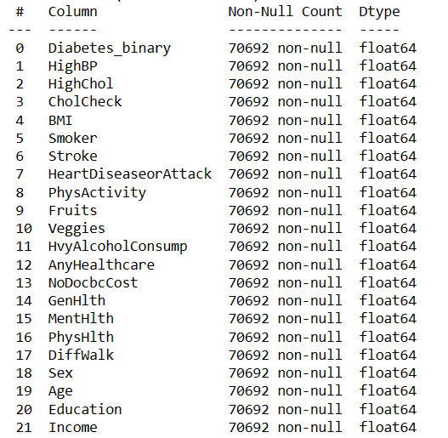
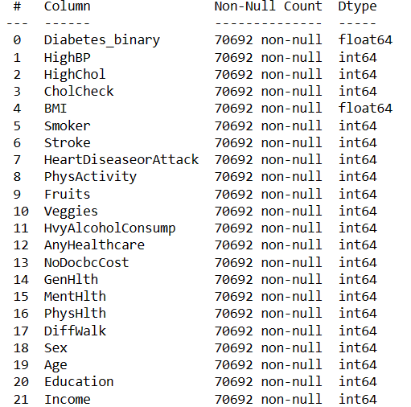
DATA CLEANING

Slide 12
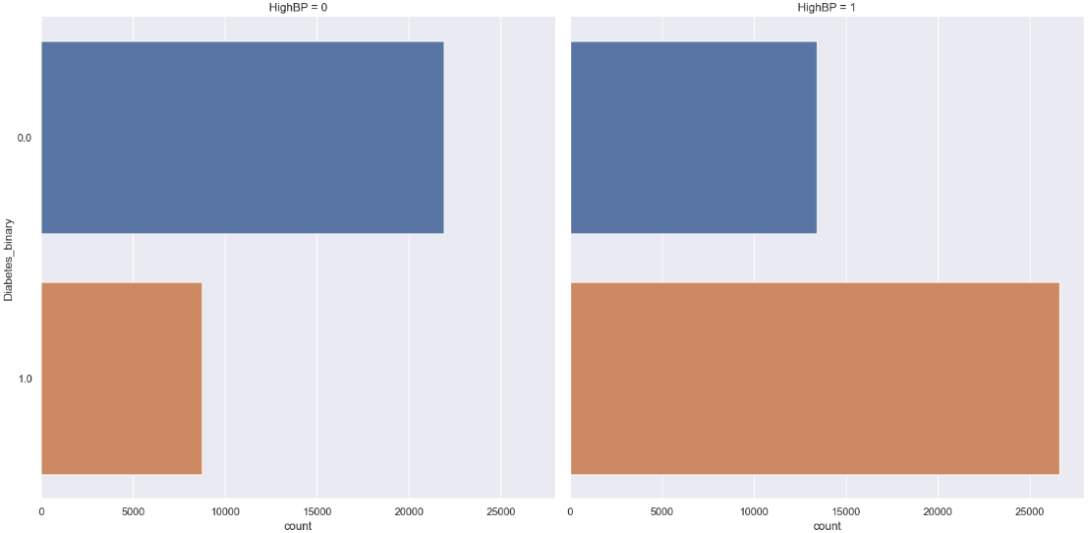
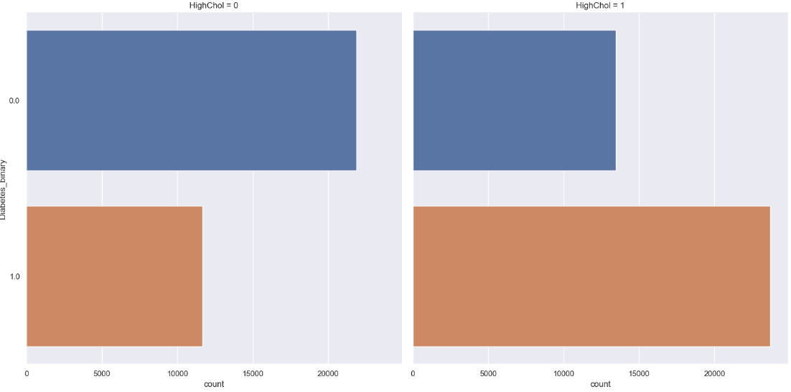
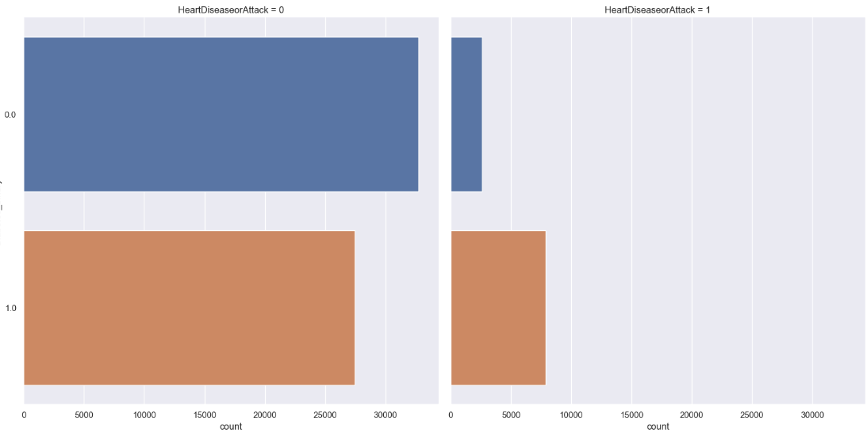
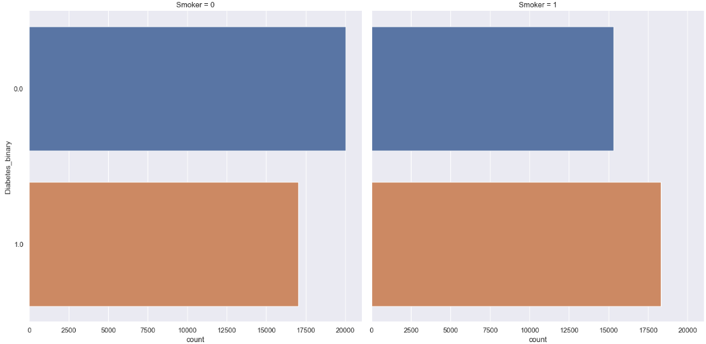
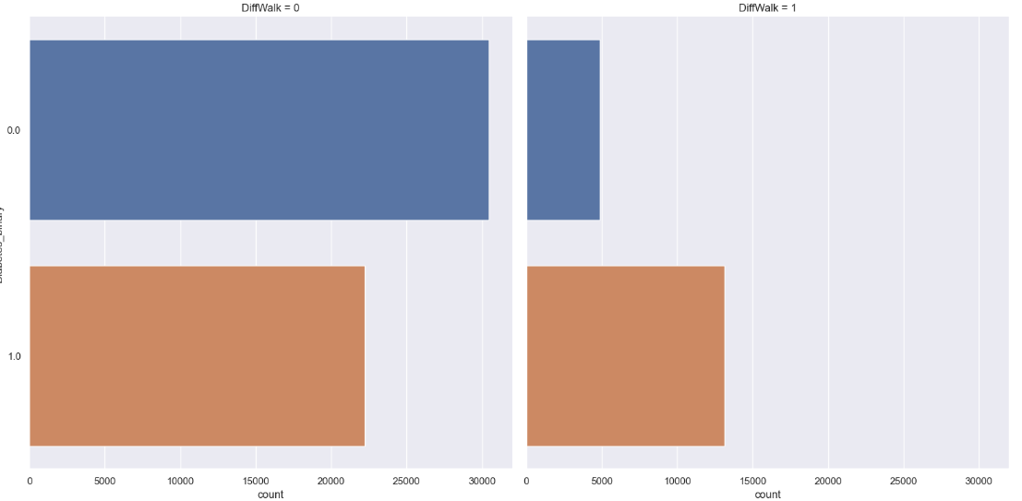
Exploratory Data Analysis
High blood pressure?
High cholesterol?
Heart disease or attack?
Is a smoker?
Difficult in walking?

Slide 13
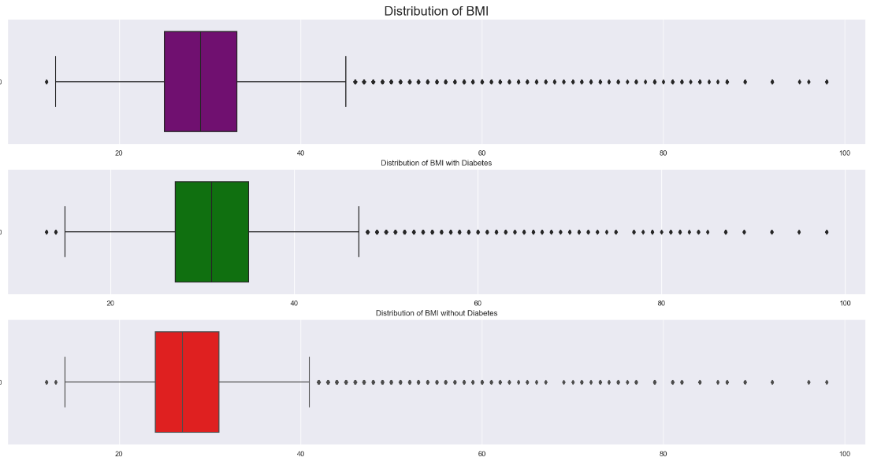
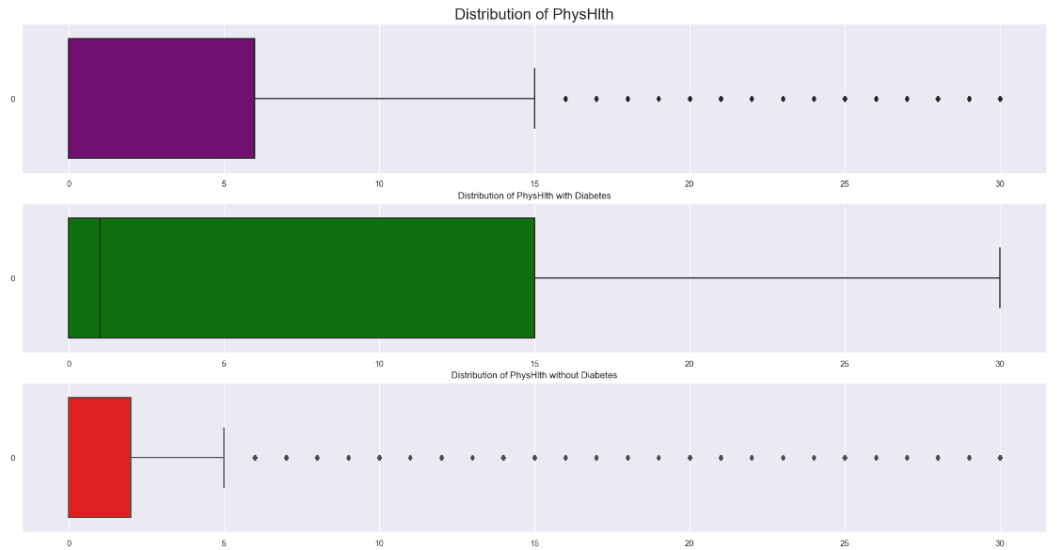
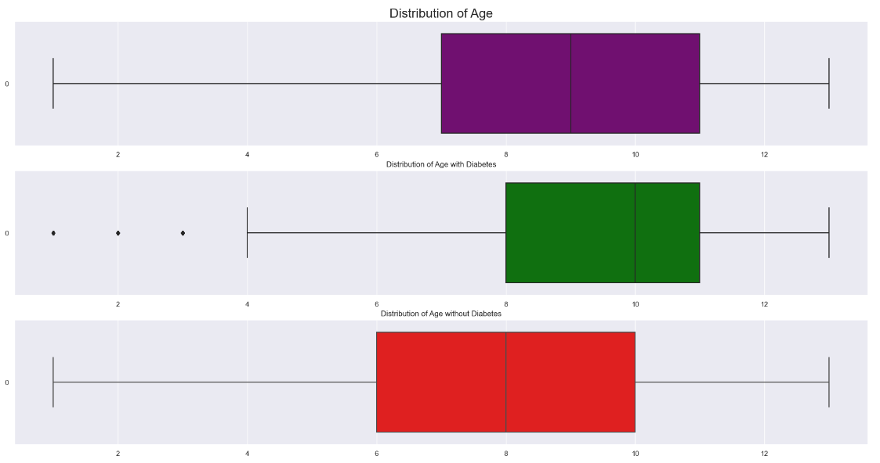
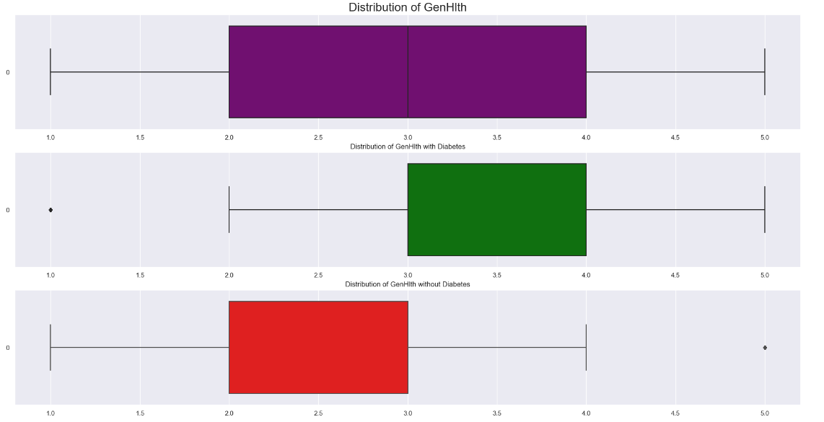
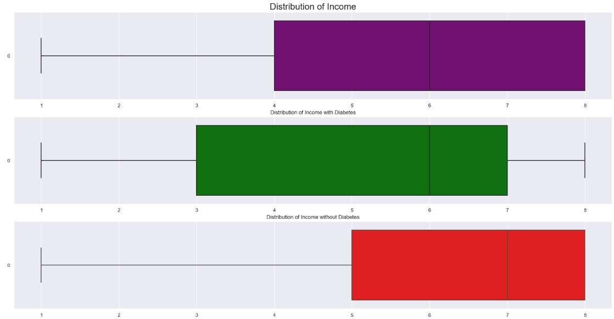
Exploratory Data Analysis
BMI
Physical Health
Age
General Health
Income

Slide 14
03
Core Analysis
Machine Learning Models
T
2

Slide 15
Model
Used
Logistic Regression
Random Forest
Gradient Boosting
A simple and more efficient method for binary and linear classification problems
An algorithm combines the output of multiple decision trees to reach a single result
A powerful boosting algorithm which each new model is trained to minimize the loss function

Slide 16
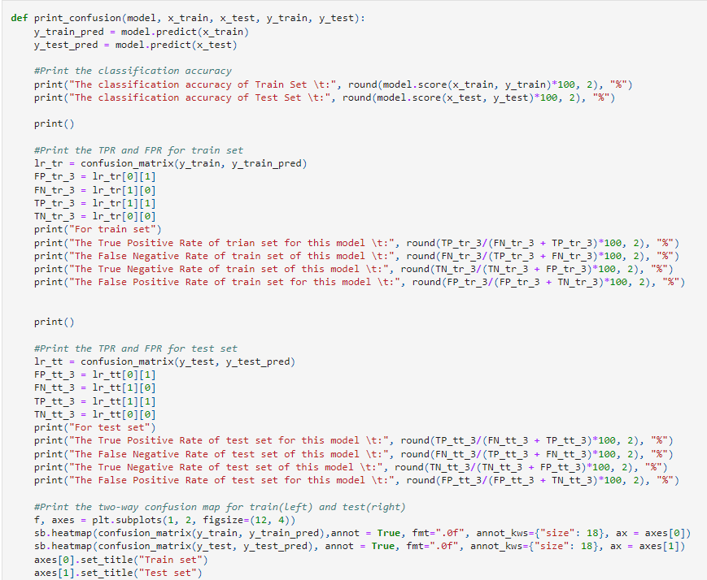
Defining Useful functions
print_confusion()
Print the confusion matrix of train and test dataset together with:
Classification Accuracy
True Positive Rate
False Negative Rate
True Negative Rate
False Positive Rate

Slide 17
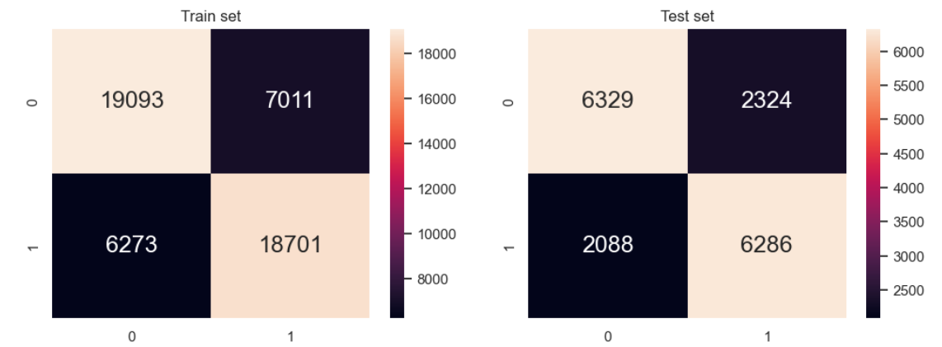
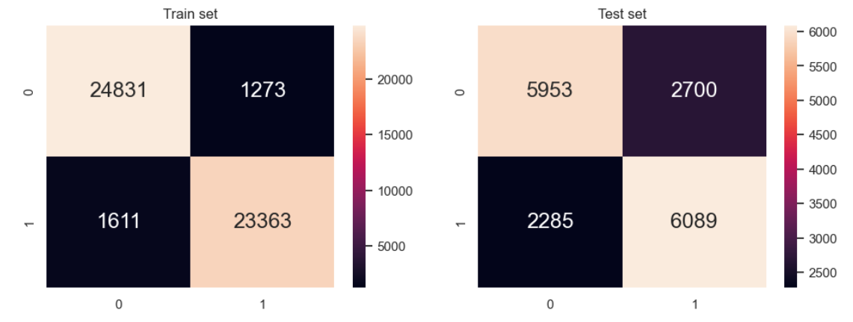
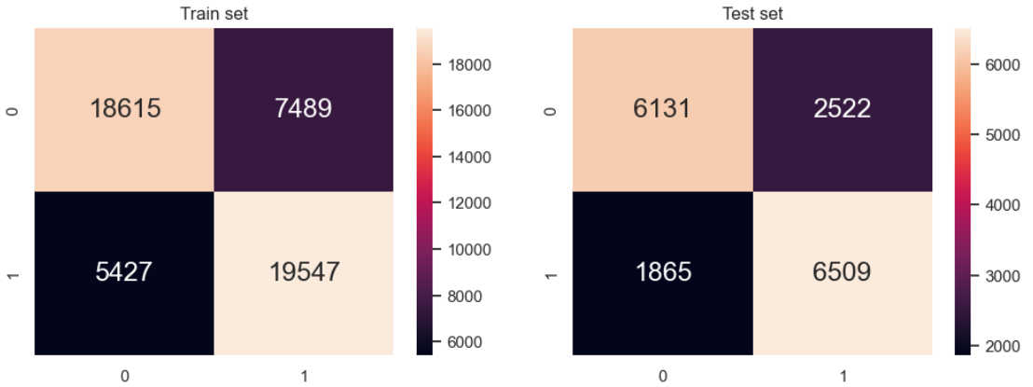
Confusion Matrix
Logistic regression
Random
Forest
Gradient Boosting

Slide 18
Model Fitting and Results
Model | Classification Accuracy [Train] (%) | Classification Accuracy [Test] (%)
Logistic Regression | 73.99 | 74.09
Random Forest Model | 94.35 | 70.72
Gradient Boosting | 74.71 | 74.24

Slide 19
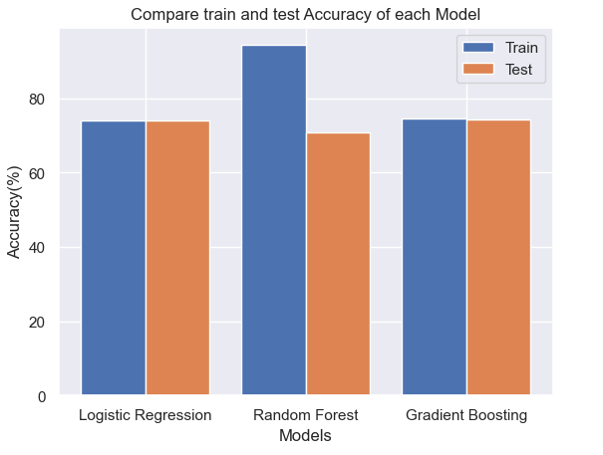
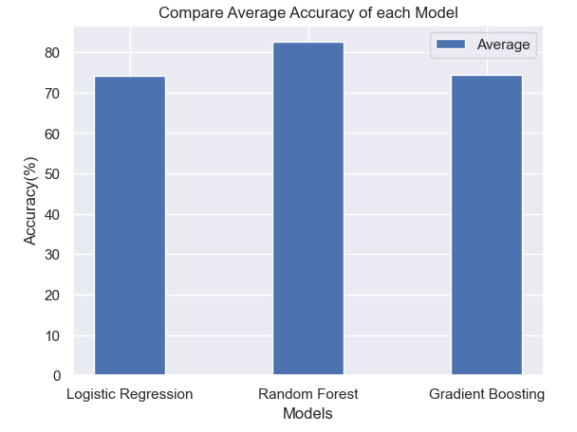
Comparing Classification Accuracy
Train & Test
Average

Slide 20
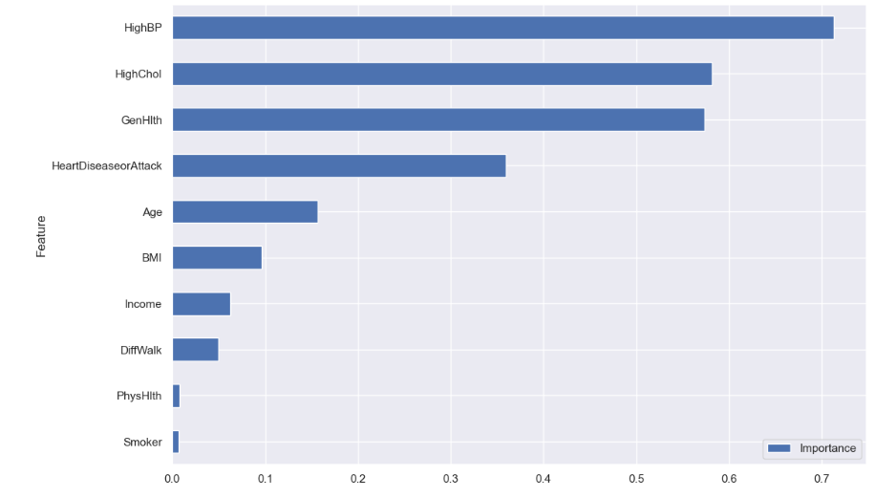
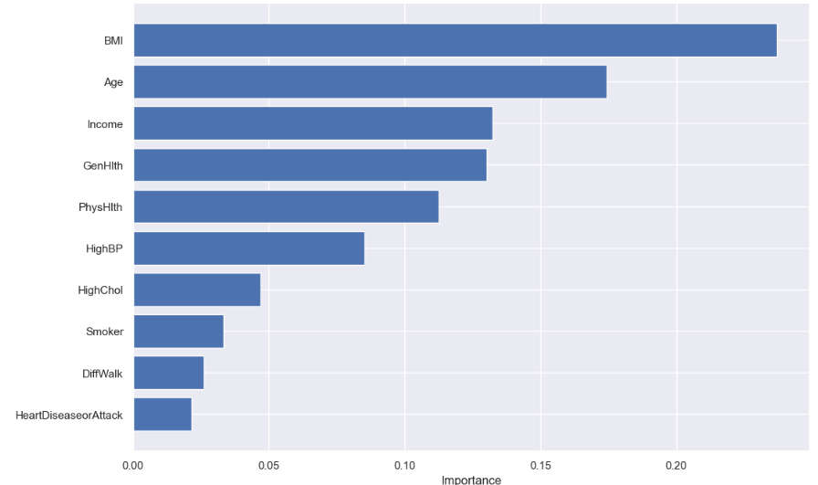
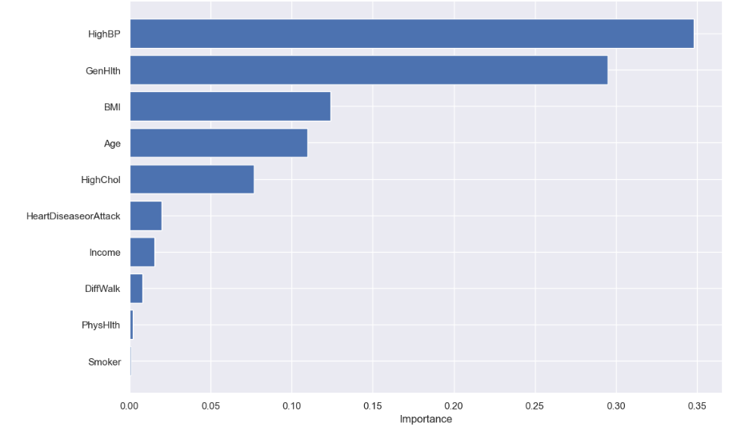
Feature Importance
Logistic
Regression
Random
Forest
Gradient
Boosting

Slide 21
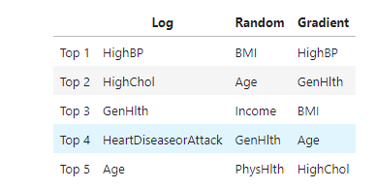
Feature Importance

Slide 22
04
Final Outcome
You can enter a subtitle here if you need it
T
3

Slide 23
PROBLEM STATEMENT
WHAT ARE THE MAIN FACTORS THAT CONTRIBUTE TO DIABETES?

Slide 24
RESULT
High Blood Pressure
BMI
High Cholesterol
Age
General Health
Income
Heart Disease or Attack
Physical Health

Slide 25
WHAT WE LEARN?
Impact of imbalance dataset and how to overcome it
New models of machine learning
Logistic Regression
Random Forest
Gradient Boosting
Project contribution through GitHub
Impact of overfitting
The main factors causing diabetes, and the awareness of taking care of our health

Slide 26
CONCLUSION
Most factors that are highly relevant to diabetes actually can be controlled by ourselves
We should start from our daily life to reduce the risk of suffering from diabetes
Even changing the different models, the factors causing diabetes are almost the same

Slide 27
THANK YOU!

